Slide 1

Lecture 1
Introduction of Waste Management
Mr. Vishwesh Mishra
Assistant Professor
Department of Mechanical Engineering
GLA University, Mathura

Slide 2
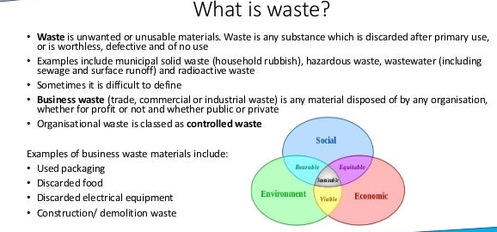

Slide 3
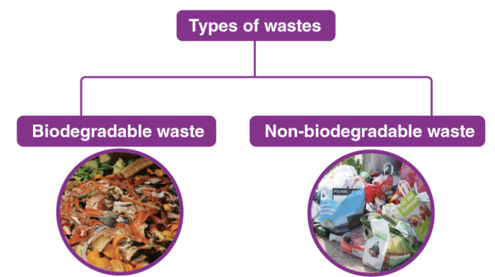

Slide 4
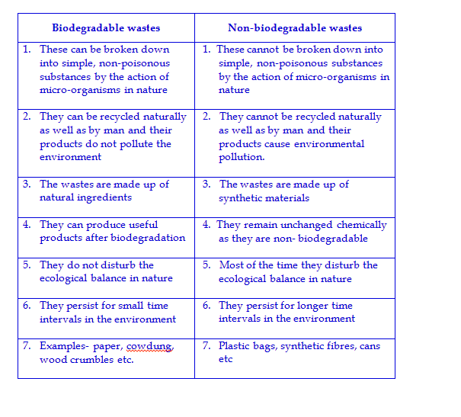

Slide 5
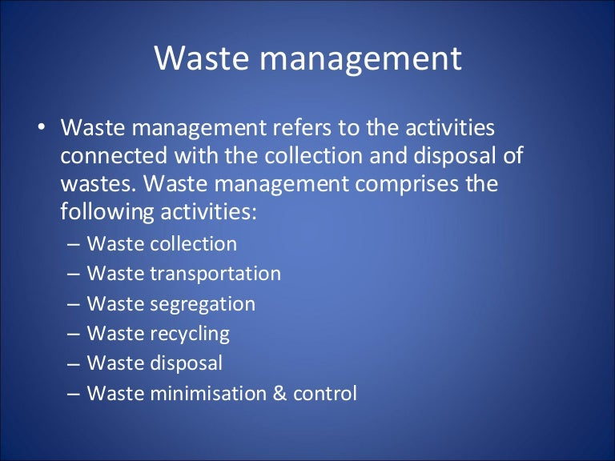

Slide 6
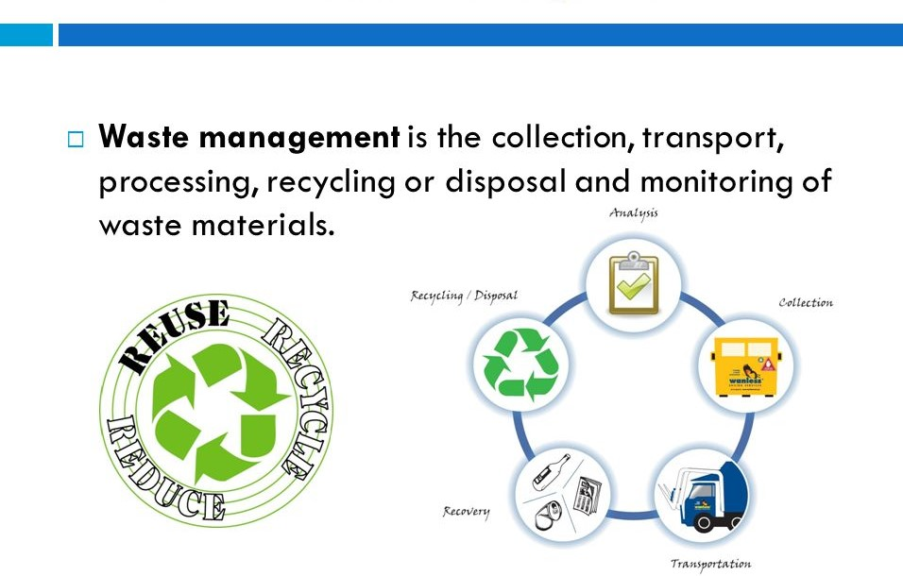

Slide 7
Reduce, Reuse, Recycle/ 3R Principal
I. Reduce: Buy only what you need because a better way to reduce waste is by not creating it.
II. Reuse: If you have to acquire goods, try getting used ones or obtaining substitutes.
III. Recycle: When discarding your waste, find ways to recycle it instead of letting it go to landfill

Slide 8
Wastes: Sources, Classification and Impact
Human society produces some unwanted and discarded materials which are called wastes.
Wastes are produced from different activities such as household activities, agricultural activities industrial activities, hospitals, educational institutions, mining operations, and so on.
These sources general different types of wastes, many of which are hazardous in nature. They cause spread of many diseases.

Slide 9
In general, the wastes maybe categorized as follows:
Solid wastes:
The solid wastes are the useless and unwanted substances discarded by human society. These include urban wastes, industrial wastes, agricultural wastes, biomedical wastes and radioactive wastes. The term refuse is also used for solid waste.

Slide 10
Liquid wastes:
Wastes generated from washing, flushing or manufacturing processes of industries are called liquid wastes. Such a waste is called sewage. The most common practice is to discharge it on the ground, nallahs, rivers and other water bodies, often without any treatment.

Slide 11
Gaseous wastes:
These wastes are released in the form of gases from automobiles, factories, burning of fossil fuels etc. and get mixed in the atmosphere. These gases include carbon monoxide, CO₂, sulphur dioxide, nitrogen dioxide, ozone, methane, etc.

Slide 12
Sources of Wastes:
Wastes produced from different sources, are classified as follows:
1. Urban or Municipal wastes
2. Industrial wastes
3. Commercial wastes
4. Agricultural wastes

Slide 13
Waste Resource and Characterization

Slide 14
Municipal Solid Waste:
The wastes, collected from the residential houses, markets, streets and other places mostly in the urban areas and disposed of by municipal bodies are called municipal solid wastes (MSW). In general, the urban solid wastes are called refuse. The Municipal solid wastes are a mixture of paper, plastic, clothes, metals, glass, organic matter etc. generated from households, commercial establishments and markets.

Slide 15
Industrial Wastes:
Industrial wastes are released from chemical plants, paint industries, cement factories, power plants, metallurgical plants, mining operations, textile industries, food processing industries petroleum industries and thermal power plants. These industries produce different types of waste products . Industrial solid wastes can be classified into two groups.

Slide 16
Non-hazardous wastes:
These wastes are produced from food processing plants, cotton mills, paper mills, sugar mills and textile industries.
:
Hazardous wastes:
Hazardous wastes are generated by nearly every industry. Metals, chemical, drugs, lather, pulp, electroplating, dye, rubber are some of important examples. Liquid Industrial waste that runs into a stream from a factory can kill the aquatic fauna and also cause health problems for humans.

Slide 17
Agricultural Wastes:
Agricultural areas produce plants and animals wastes.
Excess use of fertilizer, pesticides and other chemicals used in agriculture and the wastes formed from these cause land and water pollution. They also contaminate the soil. Among pesticides chlorinated hydrocarbons, DDT, BHC, endrin, dieldrin, lindane, parathion, malathion and endosulphon are important which are absorbed by the soil and contaminate crops grown in the soil. Other agriculture wastes are produced from sugar factories, tobacco processing units, slaughter houses, livestock, poultry etc.

Slide 18
Commercial Wastes:
With the advancement of modem cities, industries and automobiles, huge amount of wastes are generated daily. These include markets, roads, buildings, hotels, commercial complexes, hostels, auto workshops, printing press etc. Hospitals, nursing homes and medical institutes also release tremendous amount of wastes which are hazardous and are much toxic in nature.

Slide 19
Disposal of municipal solid waste
One of the major environmental problems is the collection, management and disposal of the MSW in the urban areas.
Lack of MSW management and disposal is leading to significant environmental problems.
This includes soil, air water, and aesthetic pollution. Such environmental problems are associated with human health disorder, due to the increase in greenhouse gas emissions.

Slide 20
Globally, about 71% of MSW’s are disposed of in landfills .
MSW contains, mostly, hazardous substances including some batteries, paints, mercury-containing waste, pharmaceuticals, vehicle maintenance products, and many other products .
On the other hands, more than 53% of the landfilled wastes consist of hard board paper, yard waste, papers and food that are biodegradable by the anaerobic bacteria .
This makes the land filling as the primary method of disposing waste.

Slide 21
Technologies for waste to Energy
Waste-to-Energy (WTE) technologies consist of any waste treatment process that creates energy in the form of electricity, heat or transport fuels (e.g. diesel) from a waste source.
There are number of ways of generating energy from waste. These include combustion, gasification, pyrolysis, anaerobic digestion and landfill gas recovery.

Slide 22
Most common waste-to-energy method
There are different types of waste-to-energy systems or technologies.
The most common type used in the United States is the mass-burn system, where unprocessed MSW is burned in a large incinerator with a boiler and a generator for producing electricity.

Slide 23
The process of generating electricity in a mass-burn waste-to-energy plant has seven stages
Waste is dumped from garbage trucks into a large pit.
A giant claw on a crane grabs waste and dumps it in a combustion chamber.
The waste (fuel) is burned, releasing heat.
The heat turns water into steam in a boiler.
The high-pressure steam turns the blades of a turbine generator to produce electricity.
An air pollution control system removes pollutants from the combustion gas before it is released through a smoke stack.
Ash is collected from the boiler and the air pollution control system.

Slide 24
How waste-to-energy plants work
Waste-to-energy plants burn municipal solid waste (MSW), often called garbage or trash, to produce steam in a boiler that is used to generate electricity.
MSW is a mixture of energy-rich materials such as paper, plastics, yard waste, and products made from wood. For every 100 pounds of MSW in the United States, about 85 pounds can be burned as fuel to generate electricity.

Slide 25
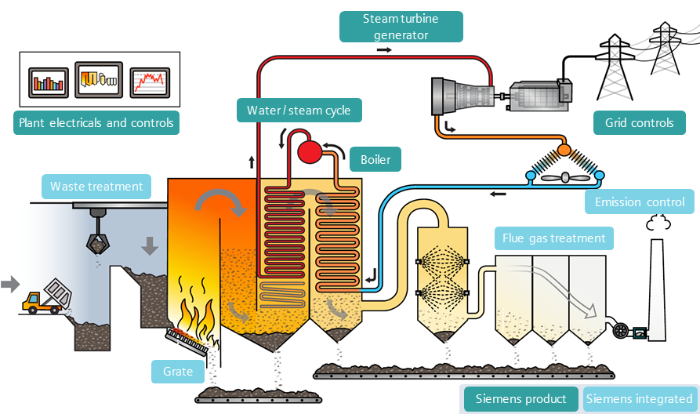

Slide 26
Gasification process
Gasification is a unique process that transforms a carbon-based material, such as MSW or biomass, into other forms of energy without actually burning it.
Instead, gasification converts the solid and liquid waste materials into a gas through a chemical reaction.

Slide 27
Gasification of waste
Thermal gasification of municipal solid waste (MSW) is a chemical process that generates a gaseous, fuel-rich product.
This product can then be combusted in a boiler, producing steam for power generation.
The main product of gasification is a mixture of gases (“producer gas”) with the main components H2, CO, CO2, H2O, CH4, and air nitrogen

Slide 28
Biomass gasification occurs in four stages
Drying: water vapor is evaporated off the biomass
Pyrolysis: the intense heat decomposes the dry biomass into organic gasses, vapors, carbon and tar, in the absence of oxygen.
Reduction: the water vapor interacts with carbon, creating hydrogen, carbon monoxide and methane.
Combustion: some of the carbon and organic chemicals burn with oxygen to produce heat, enabling the final stages of the gasification to occur

Slide 29
Utilization of biomass gasification not only reduces the need for landfill space, but also decreases the methane emissions from organic wastes that would have decomposed in the landfill.
Additionally, typical waste-to-energy plants that utilize traditional incineration methods transform one ton of municipal solid waste (MSW) into roughly 550 kilowatt-hours of electricity. With gasification technology, one ton of MSW will produce up to almost twice the kilowatt-hours that are cleaner as well.

Slide 30
How does biomass energy work?
Biomass is renewable organic material that comes from plants and animals.
Biomass was the largest source of total annual U.S. energy consumption until the mid-1800s
Most electricity generated from biomass is produced by direct combustion.
Biomass is burned in a boiler to produce high-pressure steam.
This steam flows over a series of turbine blades, causing them to rotate. The rotation of the turbine drives a generator, producing electricity.

Slide 31
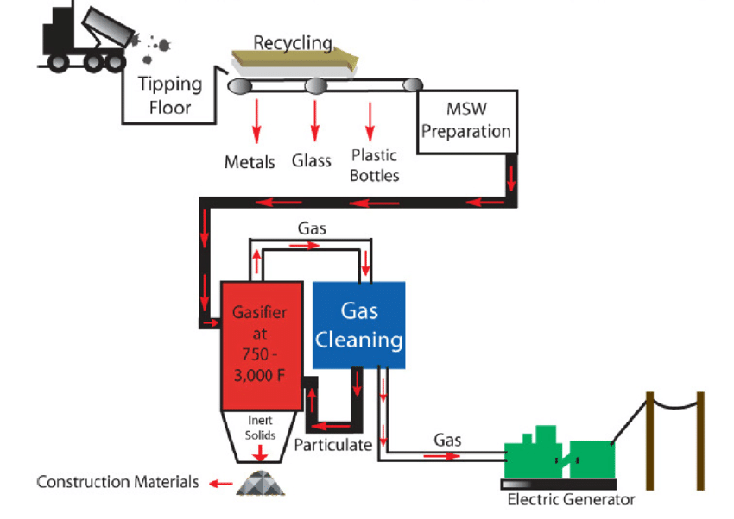

Slide 32
Pyrolysis
Pyrolysis is one of the technologies available to convert biomass to an intermediate liquid product that can be refined to drop-in hydrocarbon biofuels, oxygenated fuel additives and petrochemical replacements.
Pyrolysis is the heating of an organic material, such as biomass, in the absence of oxygen.

Slide 33
Pyrolysis is the thermal decomposition of biomass occurring in the absence of oxygen. The products of biomass pyrolysis include biochar, bio-oil and gases including methane, hydrogen, carbon monoxide, and carbon dioxide.

